Slide 1
What Is Science (Part 1)
Qualitative Observation

Slide 2

Observation
Science begins with careful observation.
Looking with a plan and prior knowledge
Looking to see what is actually there (not what you think should be there)
There are two types of observation in science.
Qualitative Observation (think quality)
Observing with your senses (e.g. sight, feel, etc.)
Quantitative Observation (think quantity)
Measuring with devices (e.g. ruler, scale, etc.)

Slide 3
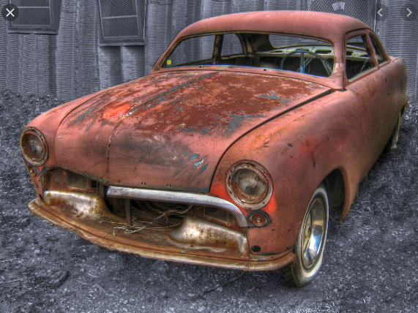
Qualitative Observation
Observing with your senses
Sight
Touch (feel)
Sound
Smell
Taste
Observing how something looks
The metal is silver, smooth, and hard
Observing how something changes
When metal rusts it becomes red, rough, and brittle

Slide 4
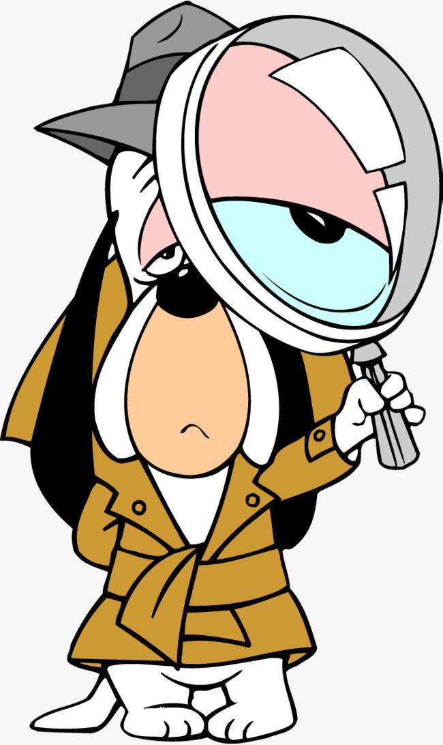
Observation Using Sight
What are some things we can see using our eyes?
Colour
Shiny or Dull
Smokey or Clear
Shape (e.g. powder, crystals, etc.)
Solid, liquid or gas (state)

Slide 5

Observation Using Touch & Sound
What are some things we can feel using our hands?
Hard or Soft
Rough or Smooth
Slippery, wet, dry
Sound can sometimes help confirm our touch observations.
Hard things sound different than soft things
Caution!
Never remove things from a sealed container or wrapper unless your teacher says it’s ok.

Slide 6
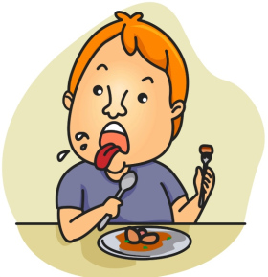
Observation Using Smell & Taste
Double Caution!!
Never, never taste anything in a science classroom
Smell requires a special procedure called “wafting”
Never smell anything unless your teacher says it’s ok
Common taste observations:
Sweet, Sour, Bitter
Common smell observations:
Nasty!

